Slide 1
PROGRESS UPDATES
NRNA COVID-19 Response to Nepali Migrant Workers-Relief and Repatriation Program
Presented By:
Dr.Badri K.C.(VP, NRNA-ICC)
Head of Department-Foreign Employment and Welfare of NRN’s
Project Director
Press Meet, 03 April 2021

Slide 2
Global Impact of COVID-19 and NRNA’s efforts
More than 63000 NRNs affected by COVID-19 global pandemic in more than 53 countries (total deaths are 341 so far).
Formation of High Level Committee to Respond COVID-19 global pandemic (with the chairmanship of NRNA ICC President).
Strategic paper shared to Nepal Government on Relief, Repatriation and Rehabilitation (3Rs).
170,000 NRNs benefitted from NRNA’s efforts on COVID-19 response (at more than 300 cities of 50 countries).
Mobilization of more than 2500 NRN volunteers globally.
Provided mental health/other medical support with the mobilization of more than 200 doctors/other trained health service providers (free health services).
Support of 13 crore NRs to Nepal Government and other logistic support (including 10 crore NRs. received from UN Agency: Relief and Repatriation Program Initiatives-collaborations with Ministry of Foreign Affairs/Diplomatic Missions at Major Destination Countries).

Slide 3
Objectives of the Program
To support Nepali Diplomatic Missions in major Middle East destination Countries and Malaysia to strengthen their capacity to provide effective consular services to Nepali migrant workers impacted by COVID-19
To provide legal/paralegal assistance and short term shelter support for the Nepali migrant workers most vulnerable from the COVID-19 and
To support Government of Nepal in providing safe and secure transit services to returning Nepali migrant workers back in Nepal.

Slide 4
Program Management Structure
cGt/f{li6«o sfo{sf/L ;lrjfno÷cGt/f{li6«o ;dGjo kl/ifb\÷j}b]lzs /f]huf/ tyf sNof0fsf/L ljefu
;+3sf] ;lrjfno
uGtJo d'n'sx?sf /fli6«o ;dGjo kl/ifb\x?
:jtGq cg'udg ;ldlt -uGtJo d'n'sx?sf /fli6«o ;dGjo kl/ifb\x? _
kl/of]hgf ;~rfng ;ldlt
pRr:t/Lo Joj:yfkg tx
s]Gb|Lo Joj:yfkg tx
:yfgLo Joj:yfkg tx
sfo{qmd Joj:yfkg l6d
-;lrjfnodf_

Slide 5
Communications with MoFA and NRNA Management
Got approval from MoFA to work on relief and repatriation initiatives for stranded Nepali migrant workers impacted by C-19.
Sharing meeting with MoFA/concerned Ministries/Embassies-major destination countries.
Regular communications with NRNA management team.
Formation and regular meeting of Project Steering Committee Meeting-clearly discussed about the project priorities, issues and implementation modality.
Regular communications with the donor and also sharing of program plus financial reports.
Sharing of case stories and other progress reports.

Slide 6
Major Activities
Mobilization of paid volunteers to complement Embassies efforts on COVID-19 response (relief and repatriation).
Provision of temporary shelter/food support.
Provision air ticket and PCR test support.
Small detention fine payment support for repatriation.
Out reach support-collaborations with Nepali Embassies (eg. renewal of passport and other needful collaborations)
Logistic support for Provincial and local government for isolation/quarantine centers (medical surgical items support).
Transportation support to needy returnee migrant workers to reach safely at home.
Counseling and documentation support at Embassies.
Telemedicine/mental health/medical assistance support.

Slide 7
Mobilization of Paid Volunteers (Destination Countries and Nepal)
NRNA recruited paid volunteers to complement and capacity development of Nepali diplomatic missions at destination countries-which was also clearly discussed with MoFA and donor/reflected on the proposal.
NRNA also mobilized unpaid volunteers along with paid volunteers to respond for relief and repatriation program (eg. ICC/NCC volunteers).
Mobilization of 25 volunteers in major destination countries and 6 volunteers in Nepal in the initial phase (till Feb 2021) and 12 volunteers (8 volunteers in major destination countries and 4 volunteers in Nepal) during extended time period- March to May 2021 (no-cost-extension plan).

Slide 8
MAJOR PROGRESS UPDATES

Slide 9
Support Provided to the Nepali Migrant Workers
So far, 16,988 Nepali Migrant workers are reached out of which 16,389 migrant workers received different types of support (such as food and shelter, counseling, outreach, PCR test, partial air ticket, documentation support etc.)

Slide 10
Categories of support provided to the migrant workers by NRNA Project Initiatives
The project has reached out to the migrant workers with various types of support.
This includes food/accommodation, counseling so as to overcome their stress, documentation support and networking with the related embassy, company, manpower, etc., PCR support, transportation support (including in Nepal) and also help them find new jobs.
In overall, out of 16,389 supported migrant workers, 2830 are provided with food and accommodations.

Slide 11
Support provided to the migrant workers by NRNA Project Initiatives in Kathmandu
Among 3292 Nepali migrant workers reached out in Kathmandu by HCA till 3rd week of March 2021, 2404 are counseled on the basis of their issues and 1010 are provided with the local transportation support.

Slide 12
Province Wise Transportation Support Details
The transportation support was provided more to the Nepali Migrant workers who are from Province 2 (322), Province 1 (282) and Lumbini Province (256).

Slide 13
Transportation support provided to the Nepali migrant workers (from KTM to place of destination-home)
1010 migrant workers have been supported with transportation by the joint initiative. 98, 229, 387, 240, 20, 6, 12, 17 and 1 of the workers from Qatar, Malaysia, Saudi, UAE, Kuwait, Bahrain, Oman, Cambodia and Russia respectively have been supported.

Slide 14
Skill Mapping of the Nepali Migrant Workers
The skill of the Nepali migrant workers is differentiated here according to their professions in their respective destination countries. Their work is categorized into unskilled, semi-skilled and skilled labor.
The 3rd week of March 2021 progress report shows that most of the migrant workers i.e. 7689 in total are practicing unskilled labor in the destination countries. Few (15) are found to be students in those countries.

Slide 15
FINANCIAL PROGRESS UPDATES

Slide 17
Budget Details | Agreed Budget (USD) | Expenses Over Agreed Budget (USD)
Shelter management/Food Expenses At Destination Countries | 128,000.00 | 79,901.74
Support for RT-PCR Test | 72,000.00 | 21,573.68
Tele-medicine/mental health/psychosocial support/medical assistance | 15,840.00 | 2,105.62
Partial support for air ticket to the most vulnerable stranded migrant workers | 329,000.00 | 45,565.05
Support to migrant workers in detention centers | 49,600.00 | 3,168.03
Volunteer salary at destination countries | 113,600.00 | 95,814.13
(Local transportation, Communication, documentation, training to Volunteers of Destination Country & Nepal) | 19,400.00 | 7,537.34
Equipment & Utilities At Destination Country | 20,153.00 | 17,788.24
Outreach At Destination Country | 20,800.00 | 10,029.10
Support provincial and local governments for safe management quarantine of returnees | 12,234.00 | 12,233.58
Volunteers Salary At Nepal | 27,100.00 | 16,659.52
Transportation support to returnee migrant workers with special need/women | 40,150.00 | 17,433.30
Partial support to vulnerable workers for hotel/public quarantine in Kathmandu | 3,136.84 | 626.00
Equipment & Utilities at Nepal | 5,132.00 | 4,260.14
Admin Support Cost (Miscellaneous) | 6,533.00 | 501.13
TOTAL | 862,678.84 | 335,196.60

Slide 18
Activities and per head cost
Major Activities | Previous plan (Sept 2020-Feb 2021) | Revised Plan (March-May 2021) (no-cost extension plan)
Air ticket | 200 persons (per head partial: 200 USD) | 940 persons (per head 350 USD almost full fare)
PCR Test | 600 persons (per head 80 USD) | 900 persons (per head 80 USD)
Shelter/food | 5600 persons (USD 30/persons) | 3200 persons (USD 40/per persons
Detention fine support | 160 persons (USD 150/persons) | 248 persons (200 USD/per persons)
Telemedicine/mental health/medical assistance | 500 persons (per head 20 USD) | 528 persons (30 USD/per persons)
Transportation support (TIA, Ktm to home) | 12500 persons | 2200 persons

Slide 19
Accountability and Transparency
Clear duty segregations for fund management/authorization based on financial polices of the organization.
Formation of monitoring committee in each destination countries to verify and monitor the expenses made.
Completed initial internal audit and separate independent third party audit process for initial phase (till Feb.2021).
Review of financial documents/ regular reports from donor.
Sample spot checks (with beneficiaries) on the support provided/update of beneficiaries details on each support categories.

Slide 20
Demographic Situation of Nepali Migrant Workers at Destination Countries (Source: NRNA, NCCs)
S.N. | Country | Documented |  | Undocumented |  | Nepali migrant workers who are in detention centers/Jail
 |  | Male | Female | Male | Female | Male | Female
1 | Qatar | 326000 | 25000 | 1200 | 30 | 65 | 30
2 | UAE | 230000 | 90000 | 12000 | 1000 | 150 | 10
3 | Malaysia | 400000 | 80000 | 18000 | 2000 | 109 | 7
4 | Saudi Arabia | 299701 | 5754 | 1500 | 0 | 300 | 0
5 | Oman | 12000 | 7000 | 30 | 100 | 0 | 0
6 | Kuwait | 45000 | 20000 | 250 | 4750 | 46 | 34
7 | Bahrain | 30000 | 5000 | 75 | 25 | 2 | 0
Total |  | 1342701 | 232754 | 33055 | 7905 | 672 | 81

Slide 21
Issues of Nepali Migrant Workers Due to COVID-19 Global Pandemic
Loss of employment opportunities (immediate need on relief, repatriation and rehabilitation-3Rs support)
Access to effective service delivery and rights of the migrant workers (advocacy initiatives/legal assistance from concerned authorities)
Mental health and other medical issues
(need of psychosocial/medical assistance)
Rehabilitation support (creating employment opportunities/growth of local economy
(Utilization/up-grade existing skills/job placement etc.)

Slide 22
Some Glimpses of Program Initiatives

Slide 23
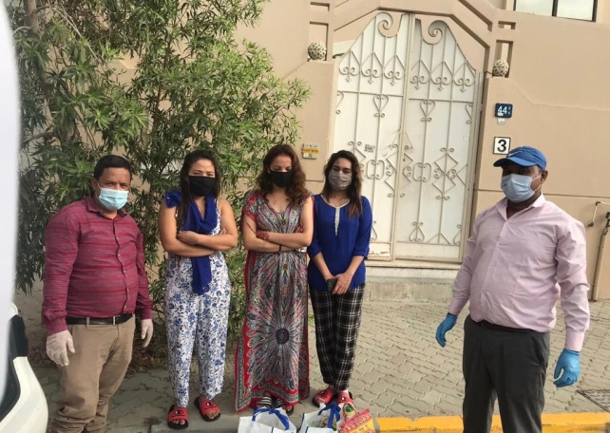
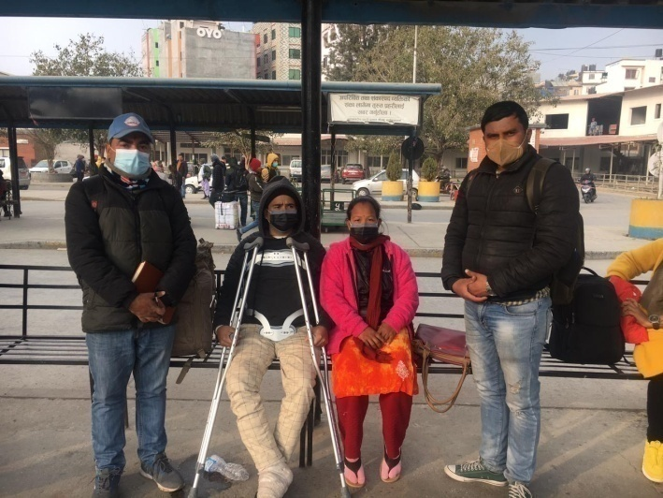
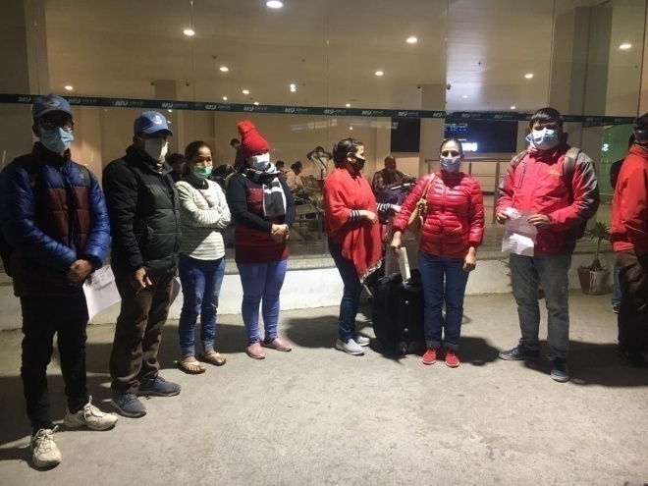
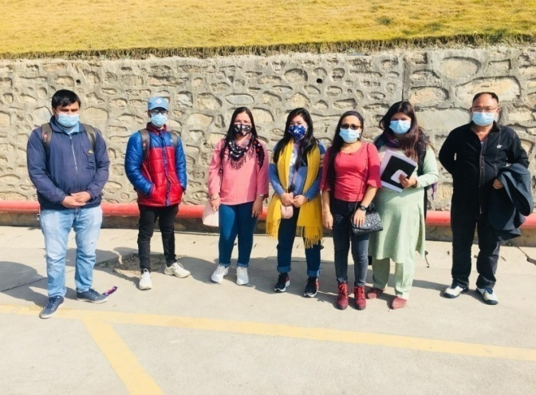
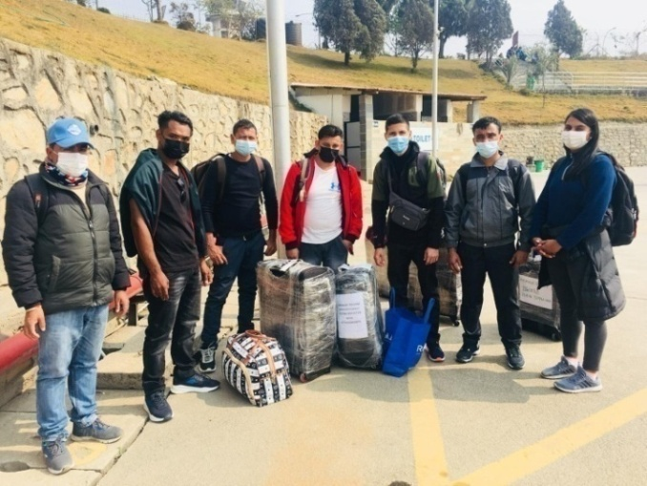

Slide 24
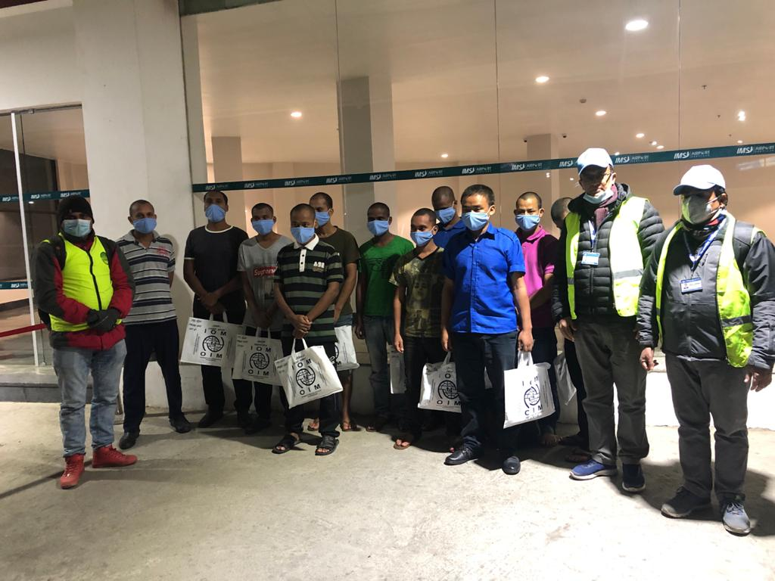
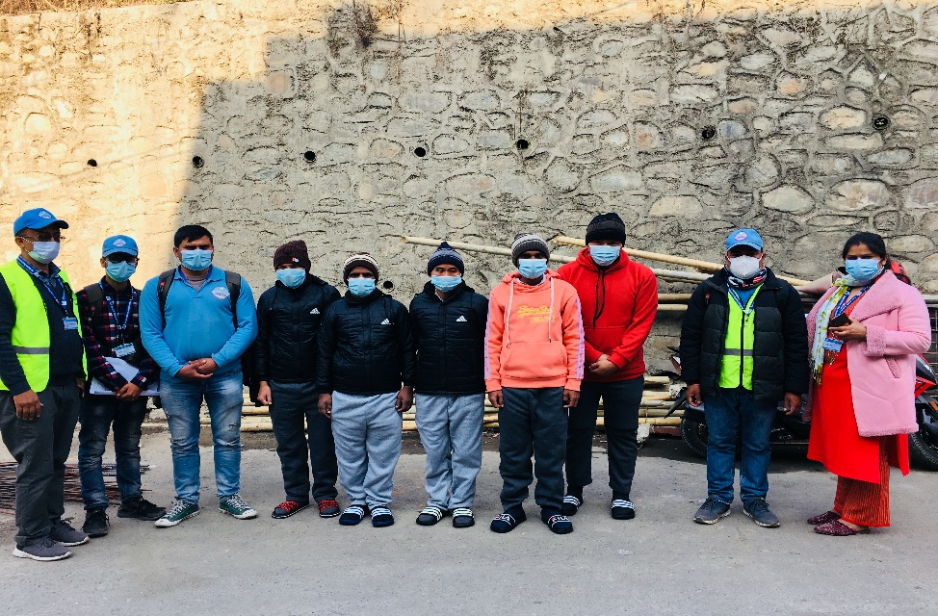
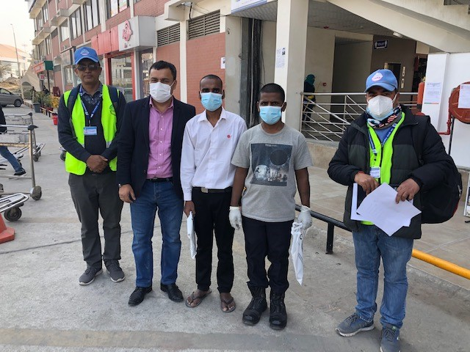

Slide 25
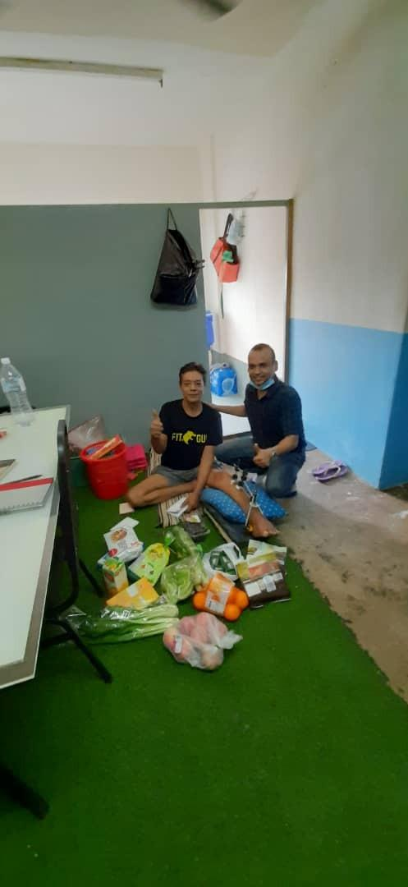
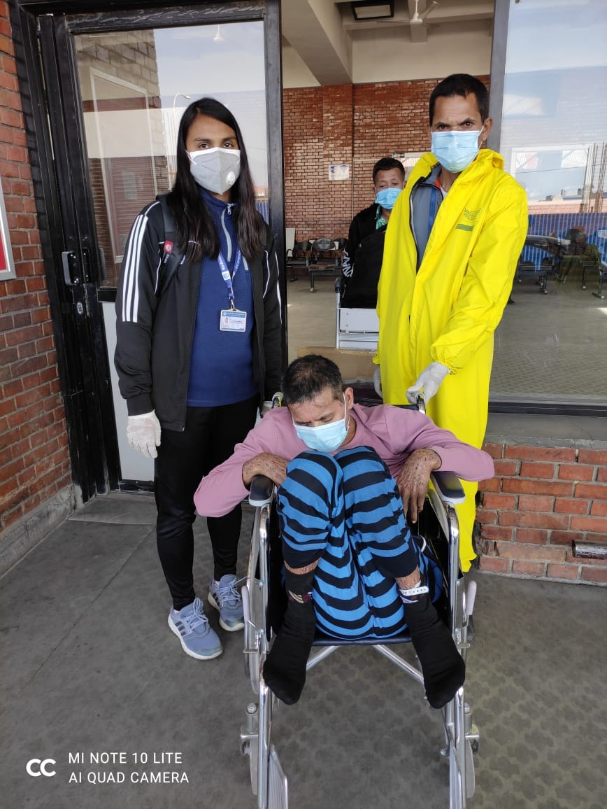
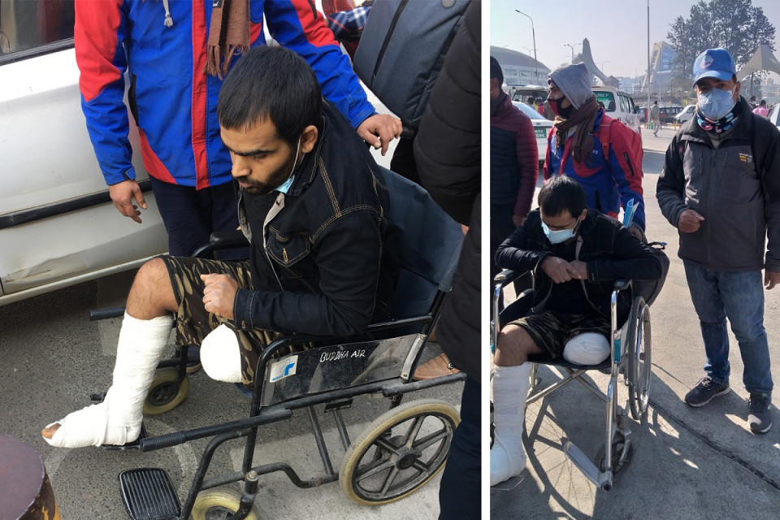
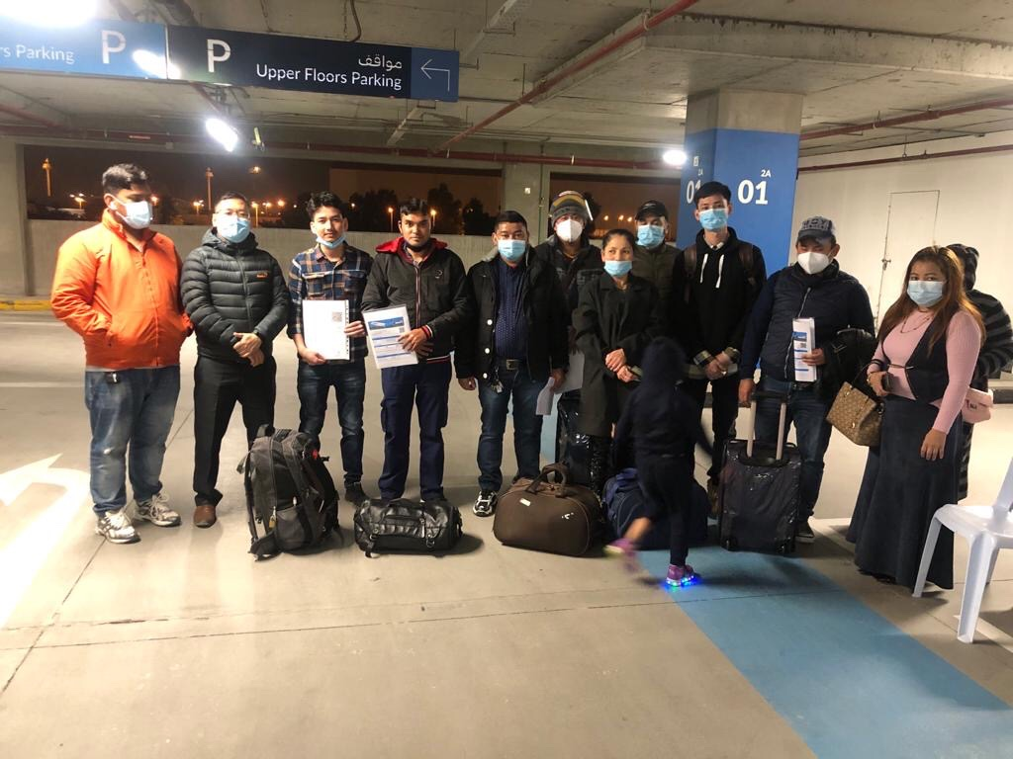

Slide 26
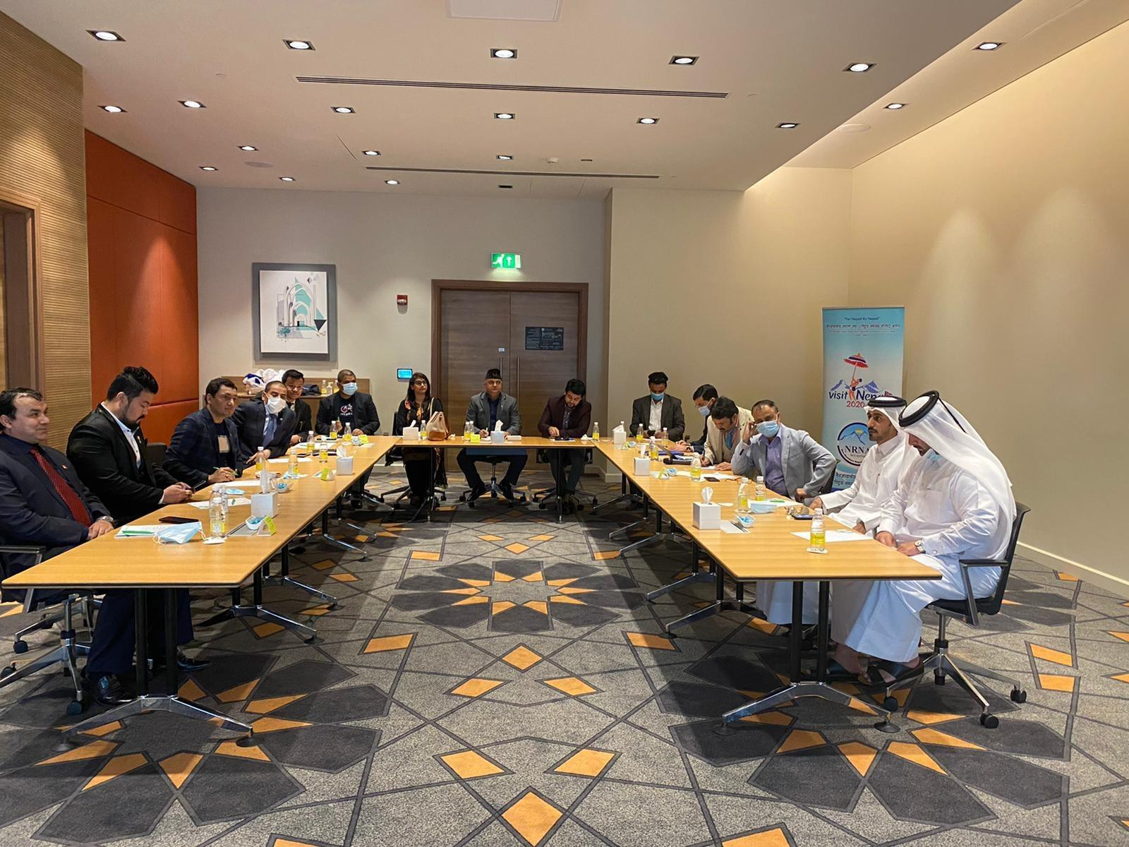
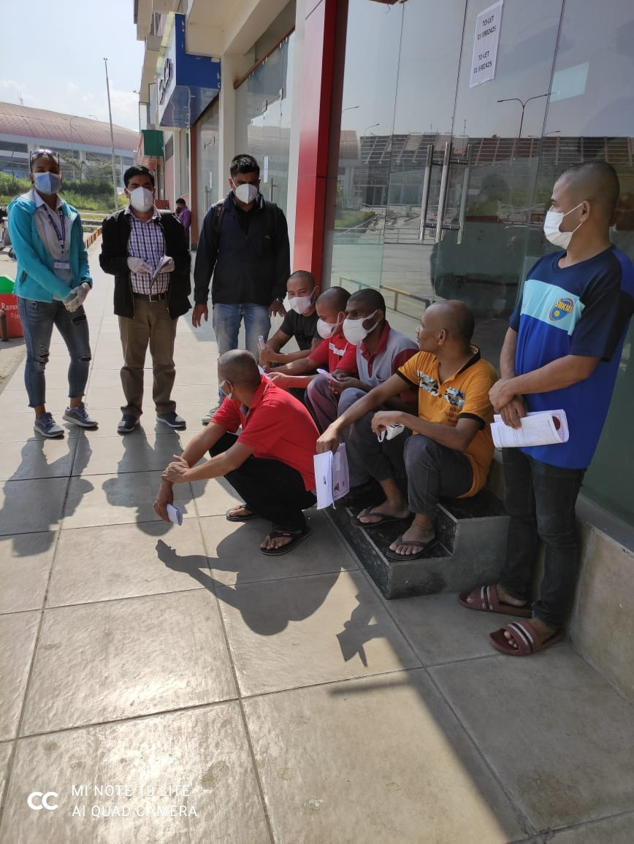
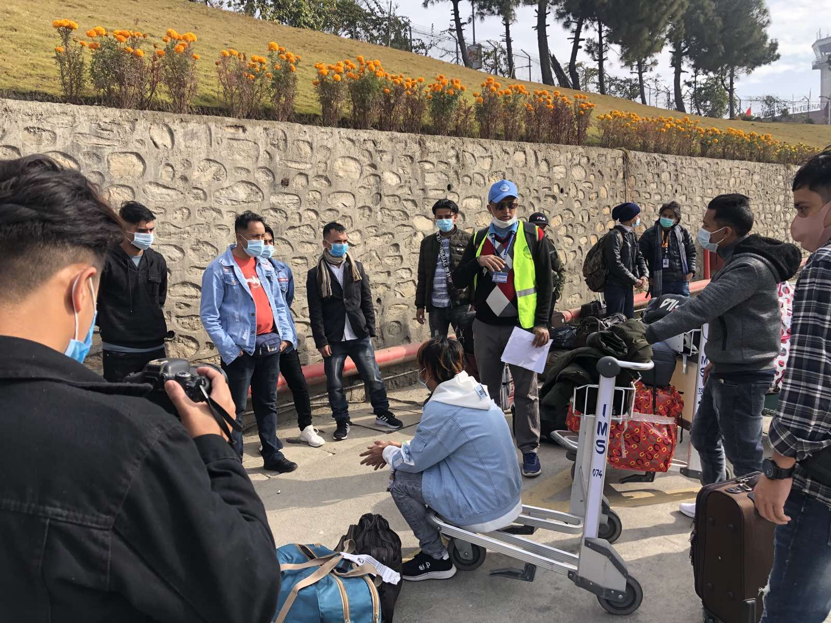

Slide 27
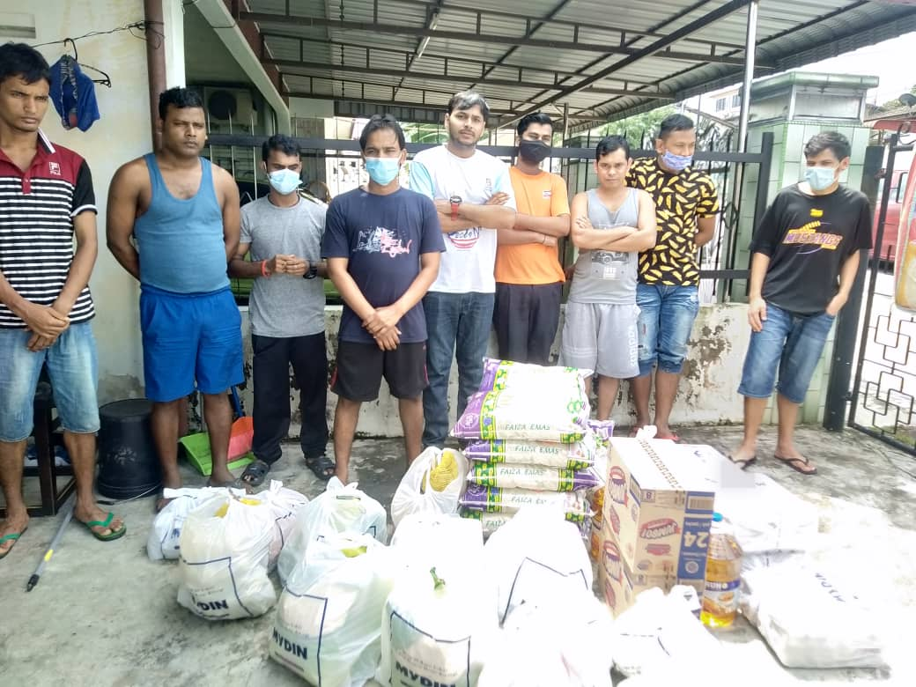
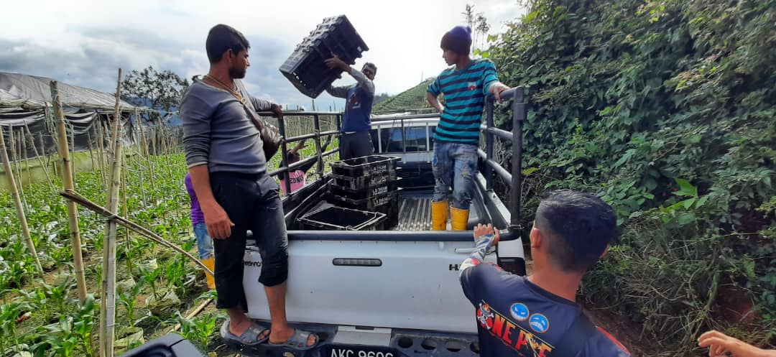
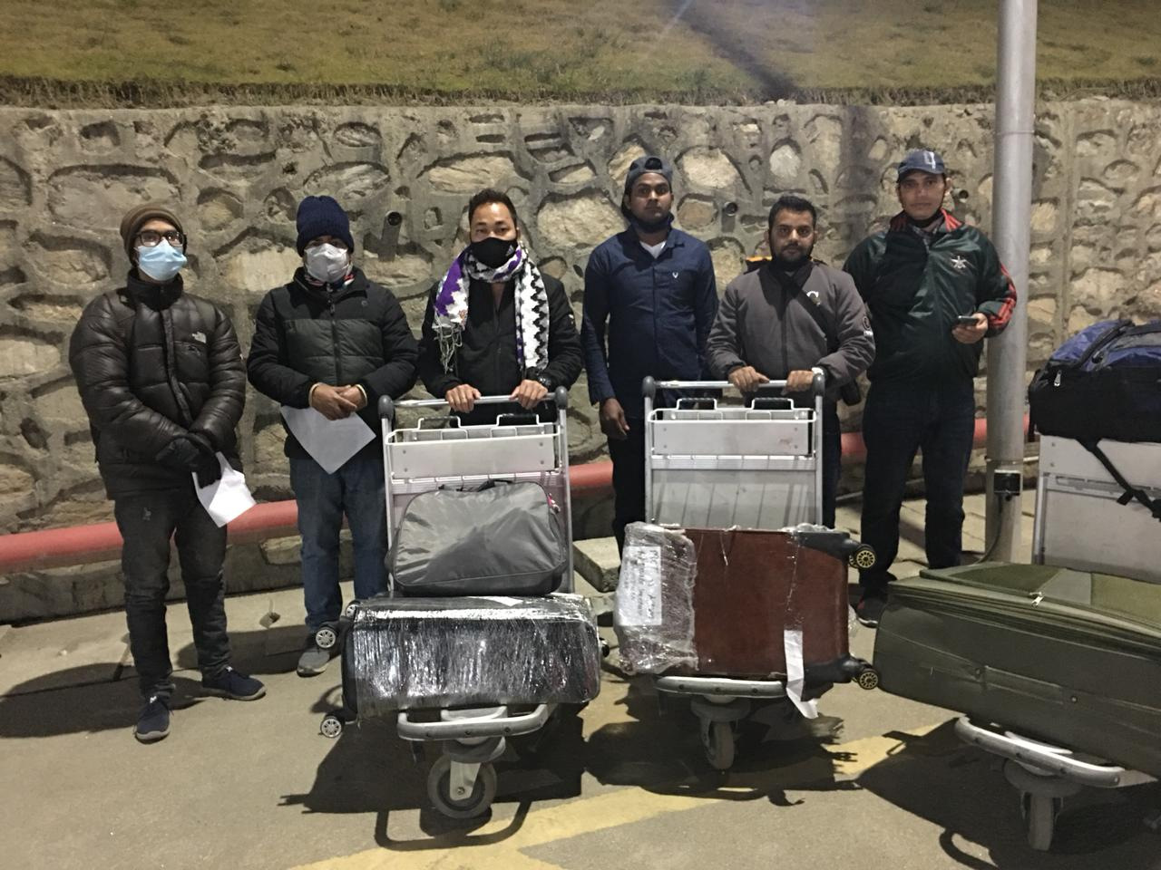
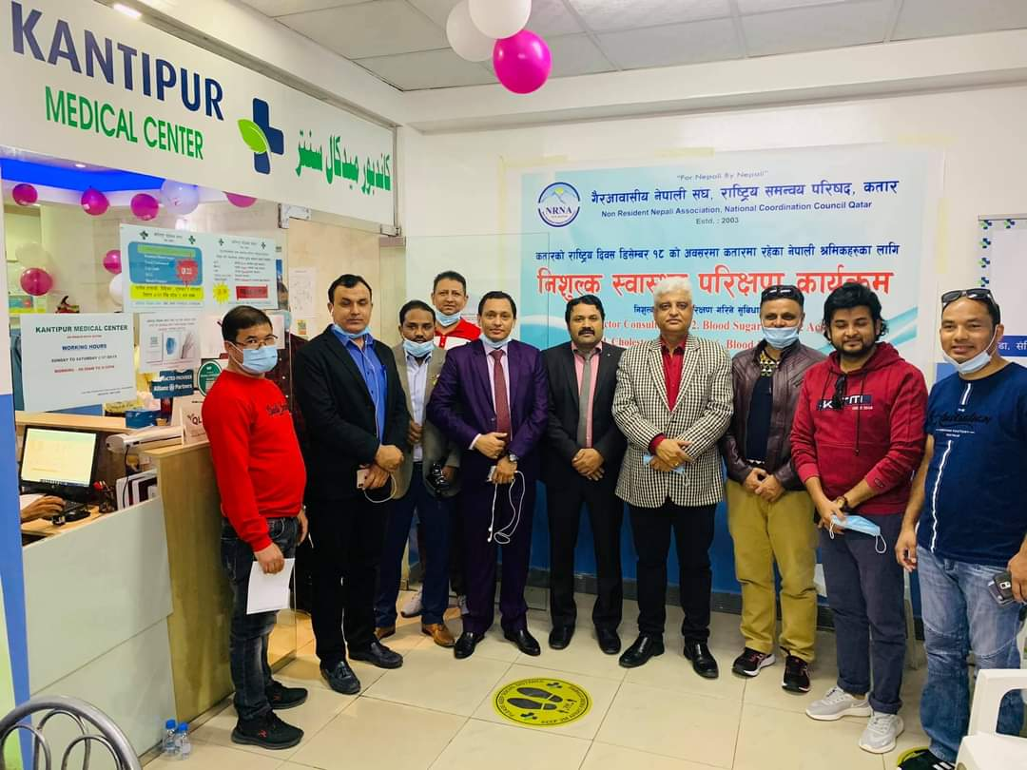
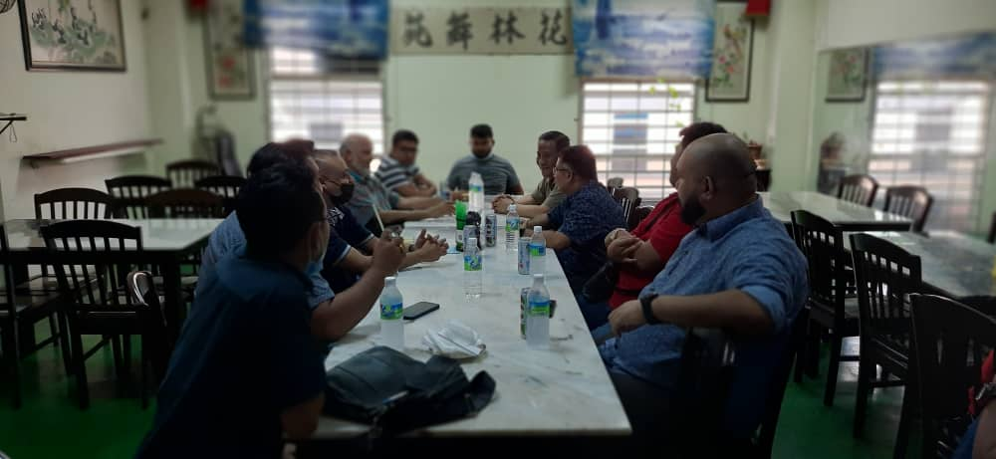

Slide 28
Thank You !!!

